Slide 1
ERROR DETECTION IN GEOMETRICAL OBJECTS(CUBE)
UNDER THE GUIDANCE OF :
PROF. PAVITHRA P
BY:
PAWAN KUMAR A(1RE13IS063)
SAI SUDARSHAN B R(1RE13IS075)
SANATH NARASIMHAN(1RE13IS077)
SYED ABRAR ALI(1RE13IS101)

Slide 2
INTRODUCTION
A portable system that can be used for simple error detection in geometrical objects.
Customized for geometrical object, a cube.
The edge length is preset for the requirement and the system determines if the requirement is met.
MATLAB is the platform of the system and three algorithms are used for the functionality.
The algorithms chosen are otsu’s thresholding algorithm and sobel edge detection algorithm.
The edge measurement algorithm is developed specially for the considered case in the system.

Slide 3
WHY ERROR DETECTION SYSTEM?
Existing error detection systems are industrial level.
They are not affordable by small scale industries, cottage industries and other startups etc.
The systems are complex and not user friendly.
To operate such systems an expert has to be present at all times.

Slide 4
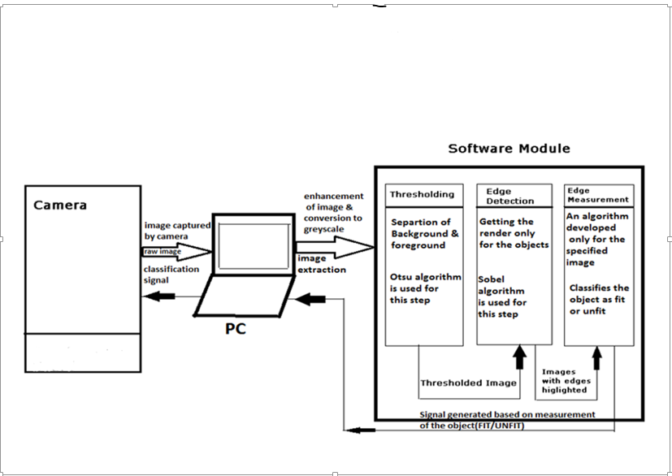
BLOCK DIAGRAM

Slide 5
STEPS INVOLVED
Capturing of image from the cameras.
Enhancement of the raw image.
Thresholding the image.
Detection of edges in the image.
Measuring the edges from the processed image.

Slide 6
CAPTURING THE IMAGE
The geometrical object picture is taken .Here it’s the picture of cube.
The picture taken is stored in the PC.
The picture is taken against a WHITE background without any shadow interfering.
Then the picture is enhanced , threshold and the edge detection is done.

Slide 7
THRESHOLDING ALGORITHM(OTSU)
Otsu's method’ (maximum variance) Thresholding is the easiest method of the image segmentation. From, thresholding converts any grayscale image to binary images.
The algorithm assumes that the image contains two classes of pixels
It calculates the optimum threshold separating the two classes.
The extension of the original method to multi-level thresholding is referred to as the multi otsu method.

Slide 8
EDGE DETECTION ALGORITHM(SOBEL)
Image edge detection is a process of locating the edge of an image .
The Sobel operator performs a 2-D spatial gradient measurement on images.
The Sobel edge detector uses a pair of 3 x 3 convolution masks.
one estimating gradient in the x-direction and the other estimating gradient in y–direction.
The Sobel detector is incredibly sensitive to noise in pictures, it effectively highlight them as edges.

Slide 9
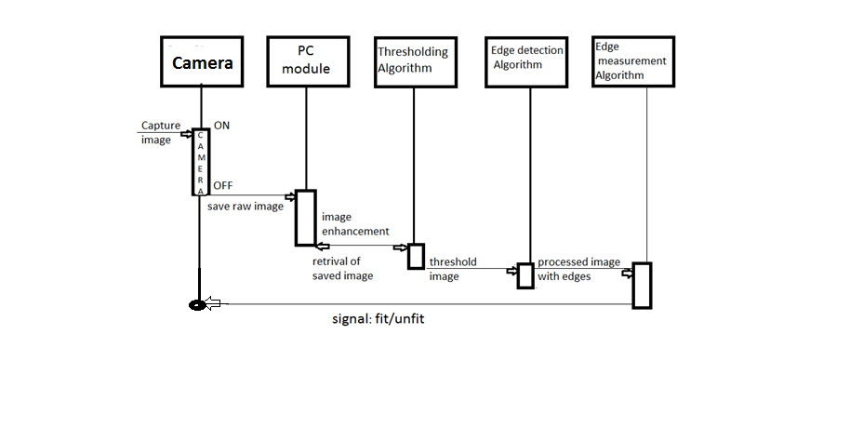
SEQUENCE DIAGRAM

Slide 10
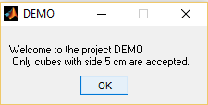
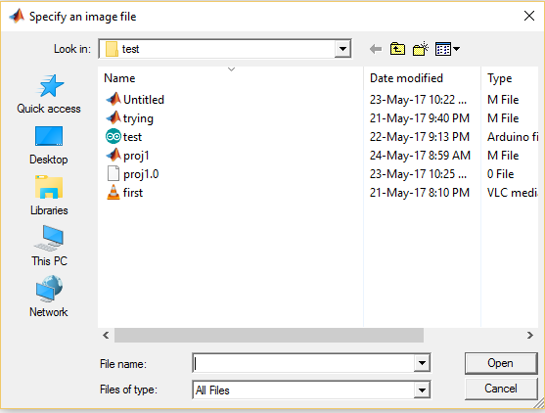
PROGAM DEVELOPED USING MATLAB
fontSize = 14;
message = sprintf ('Welcome to the project DEMO \n Only cubes with side 5 cm are accepted.')
uiwait(msgbox(message,'DEMO'));
Fig.Welcome Dialogue Box.
.
[FileName, folder] = uigetfile('*.*', 'Specify an image file');
fullImage = fullfile(folder, FileName);
if folder == 0
return;
end
rgbImage = imread(fullImage);
fig.Browsing Window

Slide 11
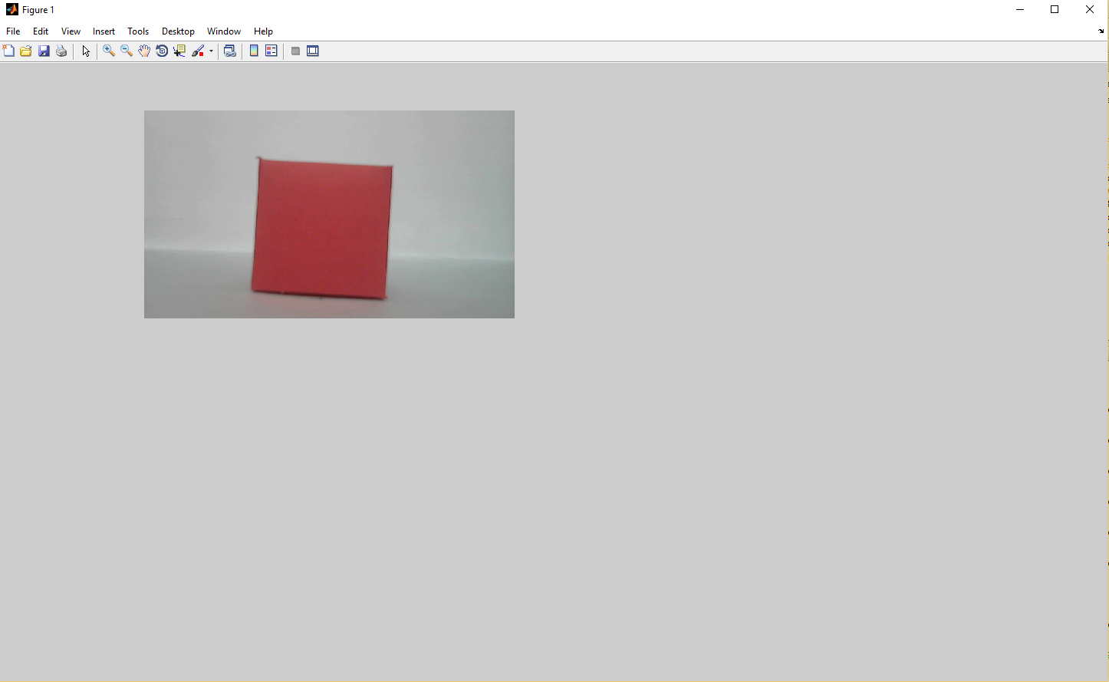
subplot(2, 2, 1);
imshow(rgbImage);
set(gcf, 'Position', get(0,'Screensize'));
set(gcf,'name','Demo by EDGO','numbertitle','off')
drawnow; % Make it display immediately.
title('Original Color Image', 'FontSize', fontSize);
fig.Output Display Window.

Slide 12
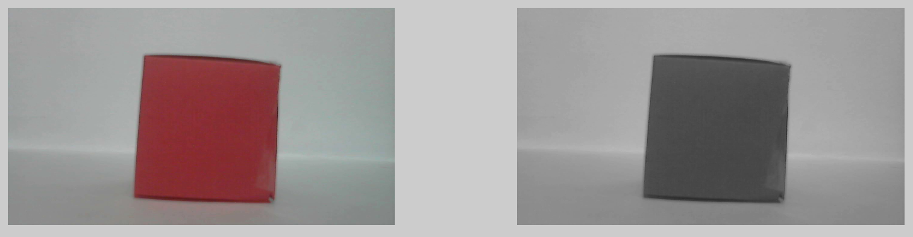
IMAGE ENHANCEMENT
grayImage = rgb2gray(rgbImage);
subplot(2, 2, 2);
imshow(grayImage);
title('Grayscale Image', 'FontSize', fontSize);
Fig.Conversion from RGB to Greyscale of the Original Image.

Slide 13
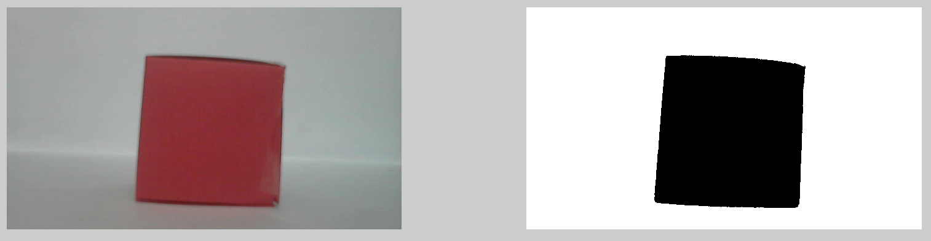
OTSU FUNCTION
level = graythresh(grayImage);
otsuImage = im2bw(grayImage, level);
subplot(2, 2, 3);
imshow(otsuImage);
title('Thresholded image by Otsu method', 'FontSize', fontSize);
Fig.Thresholded Image from Original Image.

Slide 14
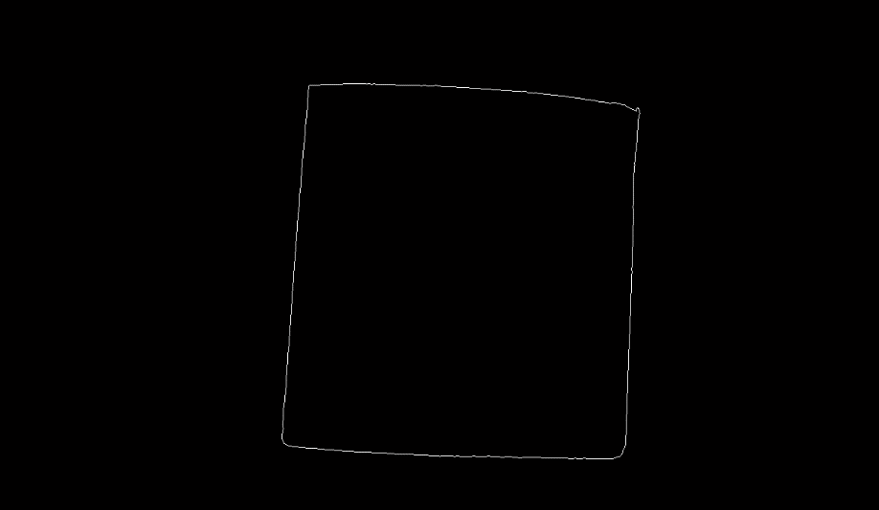
SOBEL FUNCTION
sobelImage = edge(otsuImage, 'Sobel');
subplot(2, 2, 4);
imshow(sobelImage);
title('Edges detected by Sobel method', 'FontSize', fontSize);
Fig.Image with only the edges of the object.

Slide 15
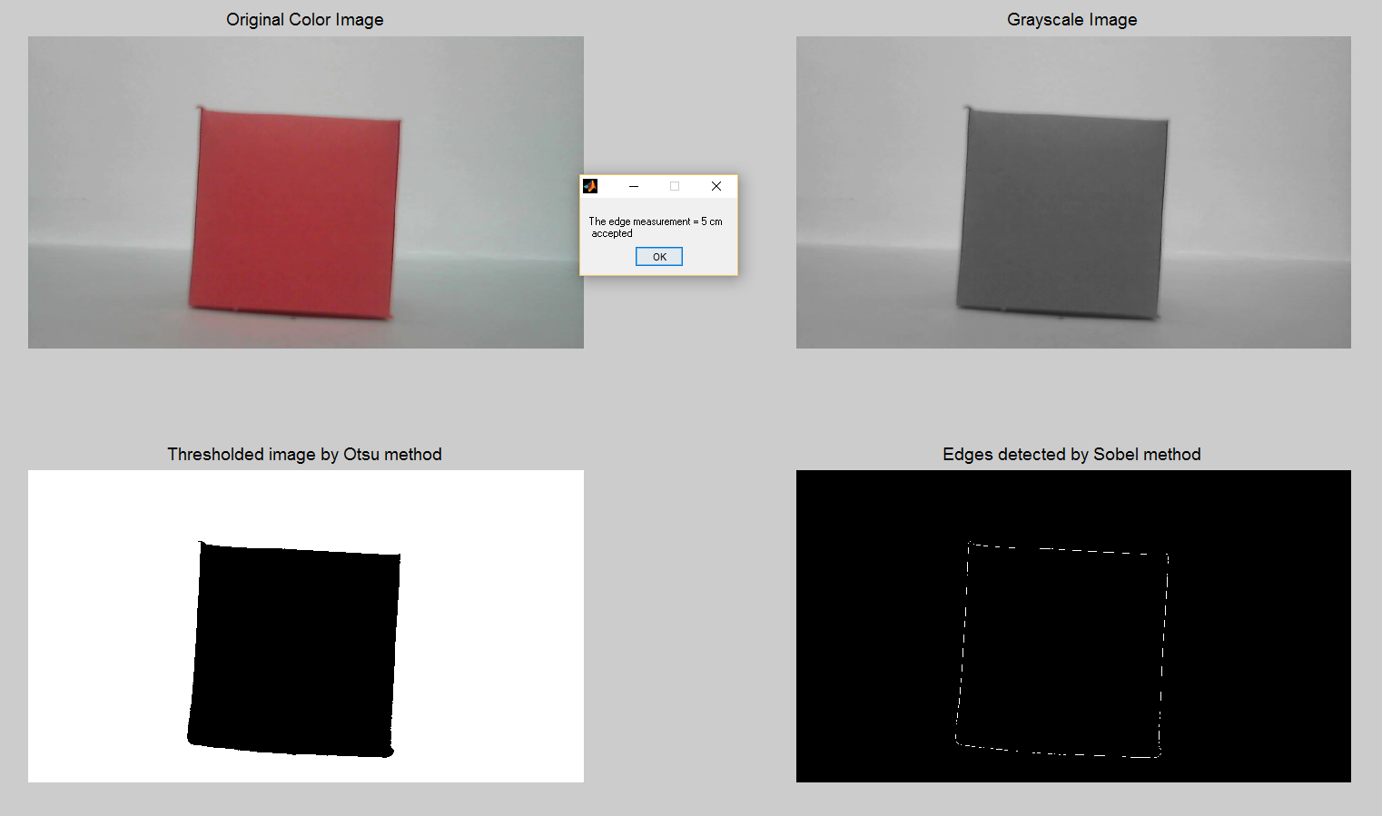
OUTPUT WINDOW

Slide 16
EDGE MEASUREMENT
ans = (nnz(sobelImage)/4);
if(ans >= 465 && ans <=485)
ed = 5;
elseif(ans >= 385 && ans <=405)
ed = 4;
elseif(ans >= 540 && ans <=560)
ed = 6;
end
if(ed == 5)
status= 'accepted';
else
status= 'rejected';
end
message = sprintf ('The edge measurement = %d cm \n %s',ed,status);
uiwait(msgbox(message));

Slide 17
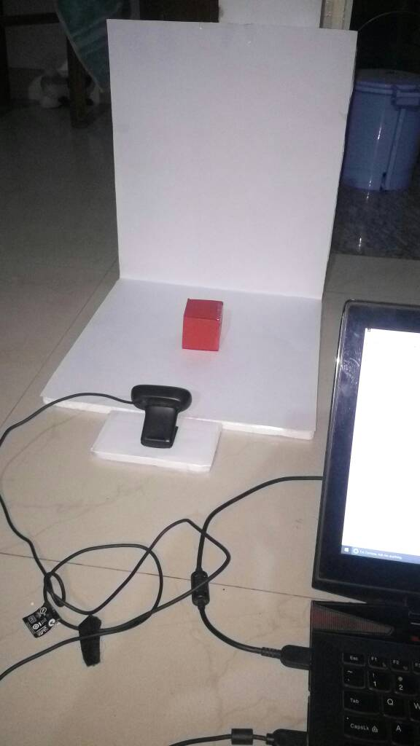
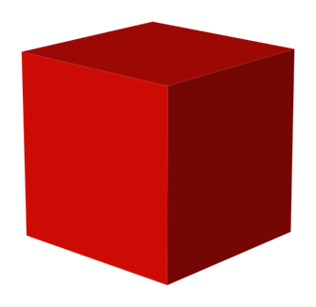


COMPONENTS
4X4
5X5
6X6

Slide 18
ADVANTAGES:
This can be used in the small scale industries.
Cost Effective.
The objects can be varied from different geometrical figures.
Efficient usage of time.
It is very useful in the application of error detection in cubes.
DISADVANTAGES:
Its not compatible for large scale industries.
Works only for Cubes.
Measurement is not accurate and cannot be used anywhere else

Slide 19
CONCLUSION
We have successfully developed a simple error detection system.
Our system is user friendly and does not require an expert to be operated.
Compared to the industry standard error detection systems, the system developed by us is cost effective.

Slide 20
FUTURE WORK
Developing an edge measurement algorithm that is more efficient.
A way to extend the error detection in other geometrical objects.
Advancement to detect errors in a user defined environment and non geometrical objects.
Automating the process.

Slide 21
REFERENCES
Campbell, J.B. 1996. Introduction to Remote Sensing. Taylor & Francis, London.
ERDAS IMAGINE 8.4 Field Guide: ERDAS Inc.
Jensen, J.R. 1996. Introduction to Digital Image Processing : A Remote Sensing Perspective. Practice Hall, New Jersey.
Lillesand, T.M. and Kiefer, R. 1993. Remote Sensing Image Interpretation. John Wiley, New York.
In.mathworks.com, edgeds, rgb2grey, imread, uiwait.
In.mathworks.com, im2bw, imshow, nnz.

